Slide 1
Action plan

Slide 2
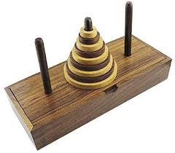
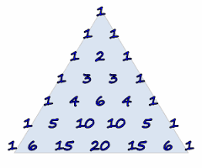
Our group has planned to include the following things in our project :-
Fibonacci series :- It is a series , characterized by the fact that, every number after the first two is the sum of the two preceding ones. Ex. 1,2,3,5,8,13,21,34,55,89
Towers of Hanoi :- The Tower of Hanoi is a mathematical game . It consists of three rods, and a number of disks of different sizes
which can slide onto any rod.
Pascal’s Triangle:-In mathematics, Pascal's triangle is a triangular array of the binomial coefficients. In the Western world, it is named after French mathematician Blaise Pascal
We are going to do research on the following topics
and make an interesting project.
So get ready to HAVE FUN WITH NUMBERS !!!!!!!!

