Slide 1
Math in engineering
By Catherine, Fleur and Nikita

Slide 2
Our plan
Our plan was to do a little experiment to see what soil is the best to build on. Then we would do an interview with an engineer specialised in soil. We would check if our research was correct. We would also have an interview with an architect.
Nikita would do the research, Catherine would do the interview with the engineer and Fleur would do the interview with the architect.

Slide 3
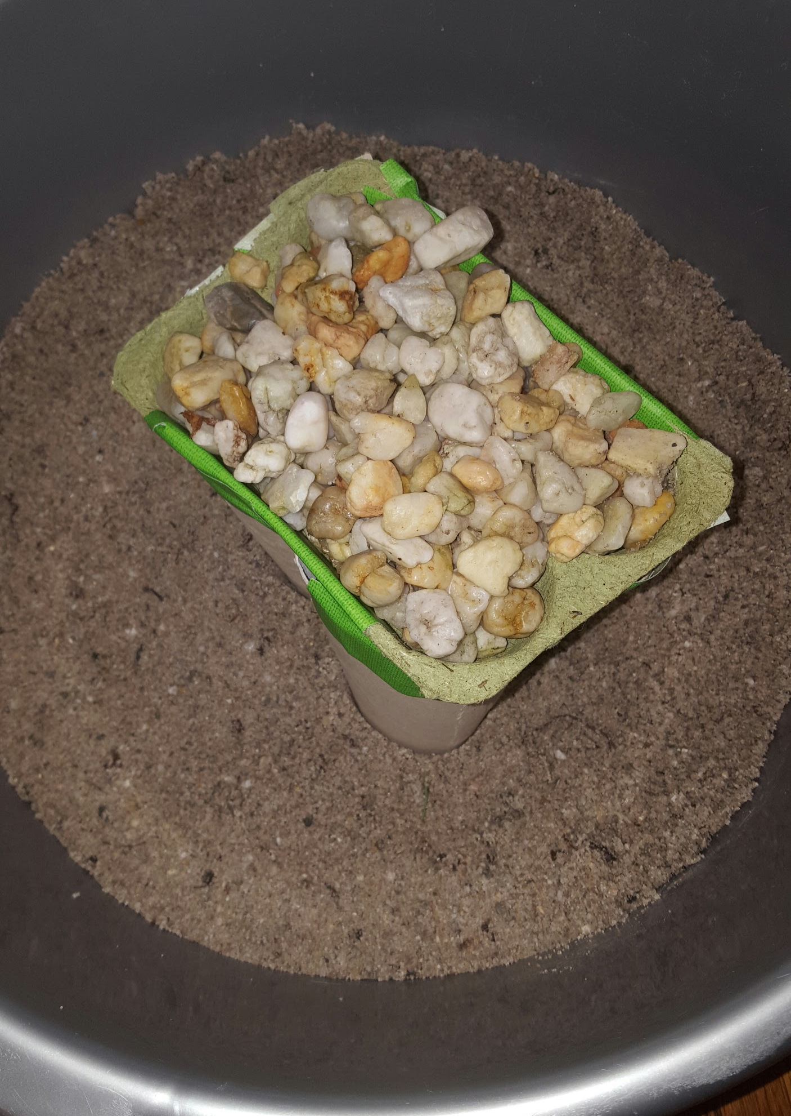
The research
Nikita made a little container, and put stones in it. She tried it with sand, and it didn’t fall. So the conclusion is that you can build on sand. The sand weighed 2673 grams. Every stone weighed around 6 grams.

Slide 4
Interview with engineer
Rob is an engineer, who is specialised in soil. He checks the soil to see if it’s suitable for a rollercoaster.
How long does it take to build a rollercoaster? It depends on the type of rollercoaster, the amount of groundwork and the finishing. Most rollercoasters take around 8 months. That is without preliminary studies and design.
How long does it take to build a house in the Netherlands? A traditional house, including the finishing, also takes about 8 months. Preferably faster of course! Sometimes it can even be finished in a few dates.
What makes a soil appropriate for a rollercoaster? It has to be load bearing. Sand works well, but loam, clay and peat doesn’t. If the ground isn’t load bearing, you can put poles in the ground on a deeper load bearing ground.
What materials do you use for the soil when you build houses? You found a house on a load bearing ground, like sand. If it is a thin non-load bearing layer, thinner than 2 meter, you can dug it out and replace it with sand. If the non-load bearing ground is deeper, you can use foundation poles.
What do you use to stabilise a rollercoaster? You make sure you have a good foundation. You have to count on different burdens, such as wind, the weight of the carts and dynamic burdens. You can calculate these powers, and make the construction suitable.
What is involved in building a rollercoaster? The design is very important. You have to take care of the stability. Also you have to think of the amount of G-forces it has. The more, the better. And of course safety is imporatant. Also you have to use low-maintenance products, to keep the price low.

Slide 5
Interview with architect
1. How do you start with drawing plans for a building? From a standard questionnaire with the costumer we go through their wishes. From that information we first make v sketches.
2. Does it often happen that the wrong amounts of products for the building are calculated? It doesn't happen that we have too much, or it must be a wrong order. Too little happens when the product is used worldwide (on that moment) .
3. How long does it take to build a house? The building of a house takes on average 10 to 11 months, This depends on How big the house needs to be.
4. How do you know if the soil you are building on is good? The application of a house (at the townhouse) needs to go with a ground research record what gives is the weight that the ground can take.
5. What kind of houses or apartments are build the most at the moment, and why? This depends on where we need to build the house. In villages where there is a high request we mostly can't build anything else but appartments.

