Slide 1
EUMIND
INTRODUCTION

Slide 2
GROUP MEMBERS
PRATHEMESH SATPUTE
YASH SHINDE
DARSH JHALA
SHRAVANI SAWANT
AMRUTHAVALLI Chivukula
ADVAIT KELAPURE

Slide 3
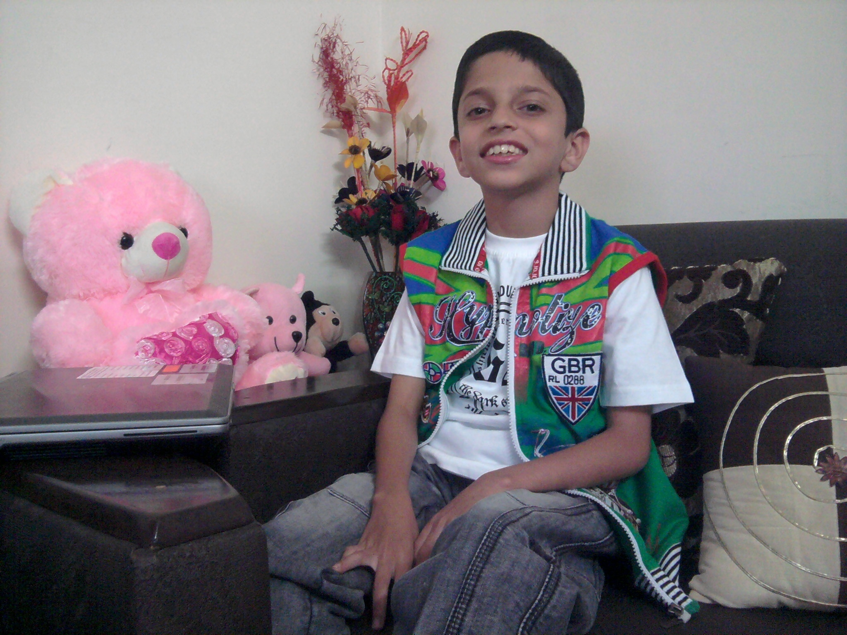
Hello! My name is Prathemesh. I am fourteen years old. This year I am the student editor of my group and our topic is “MATH CONTRIBUTORS”.
My hobbies are playing musical instruments like tablature and piano and I love maths a lot.
My ambition is to become the
CEO of a renowned software
company

Slide 4
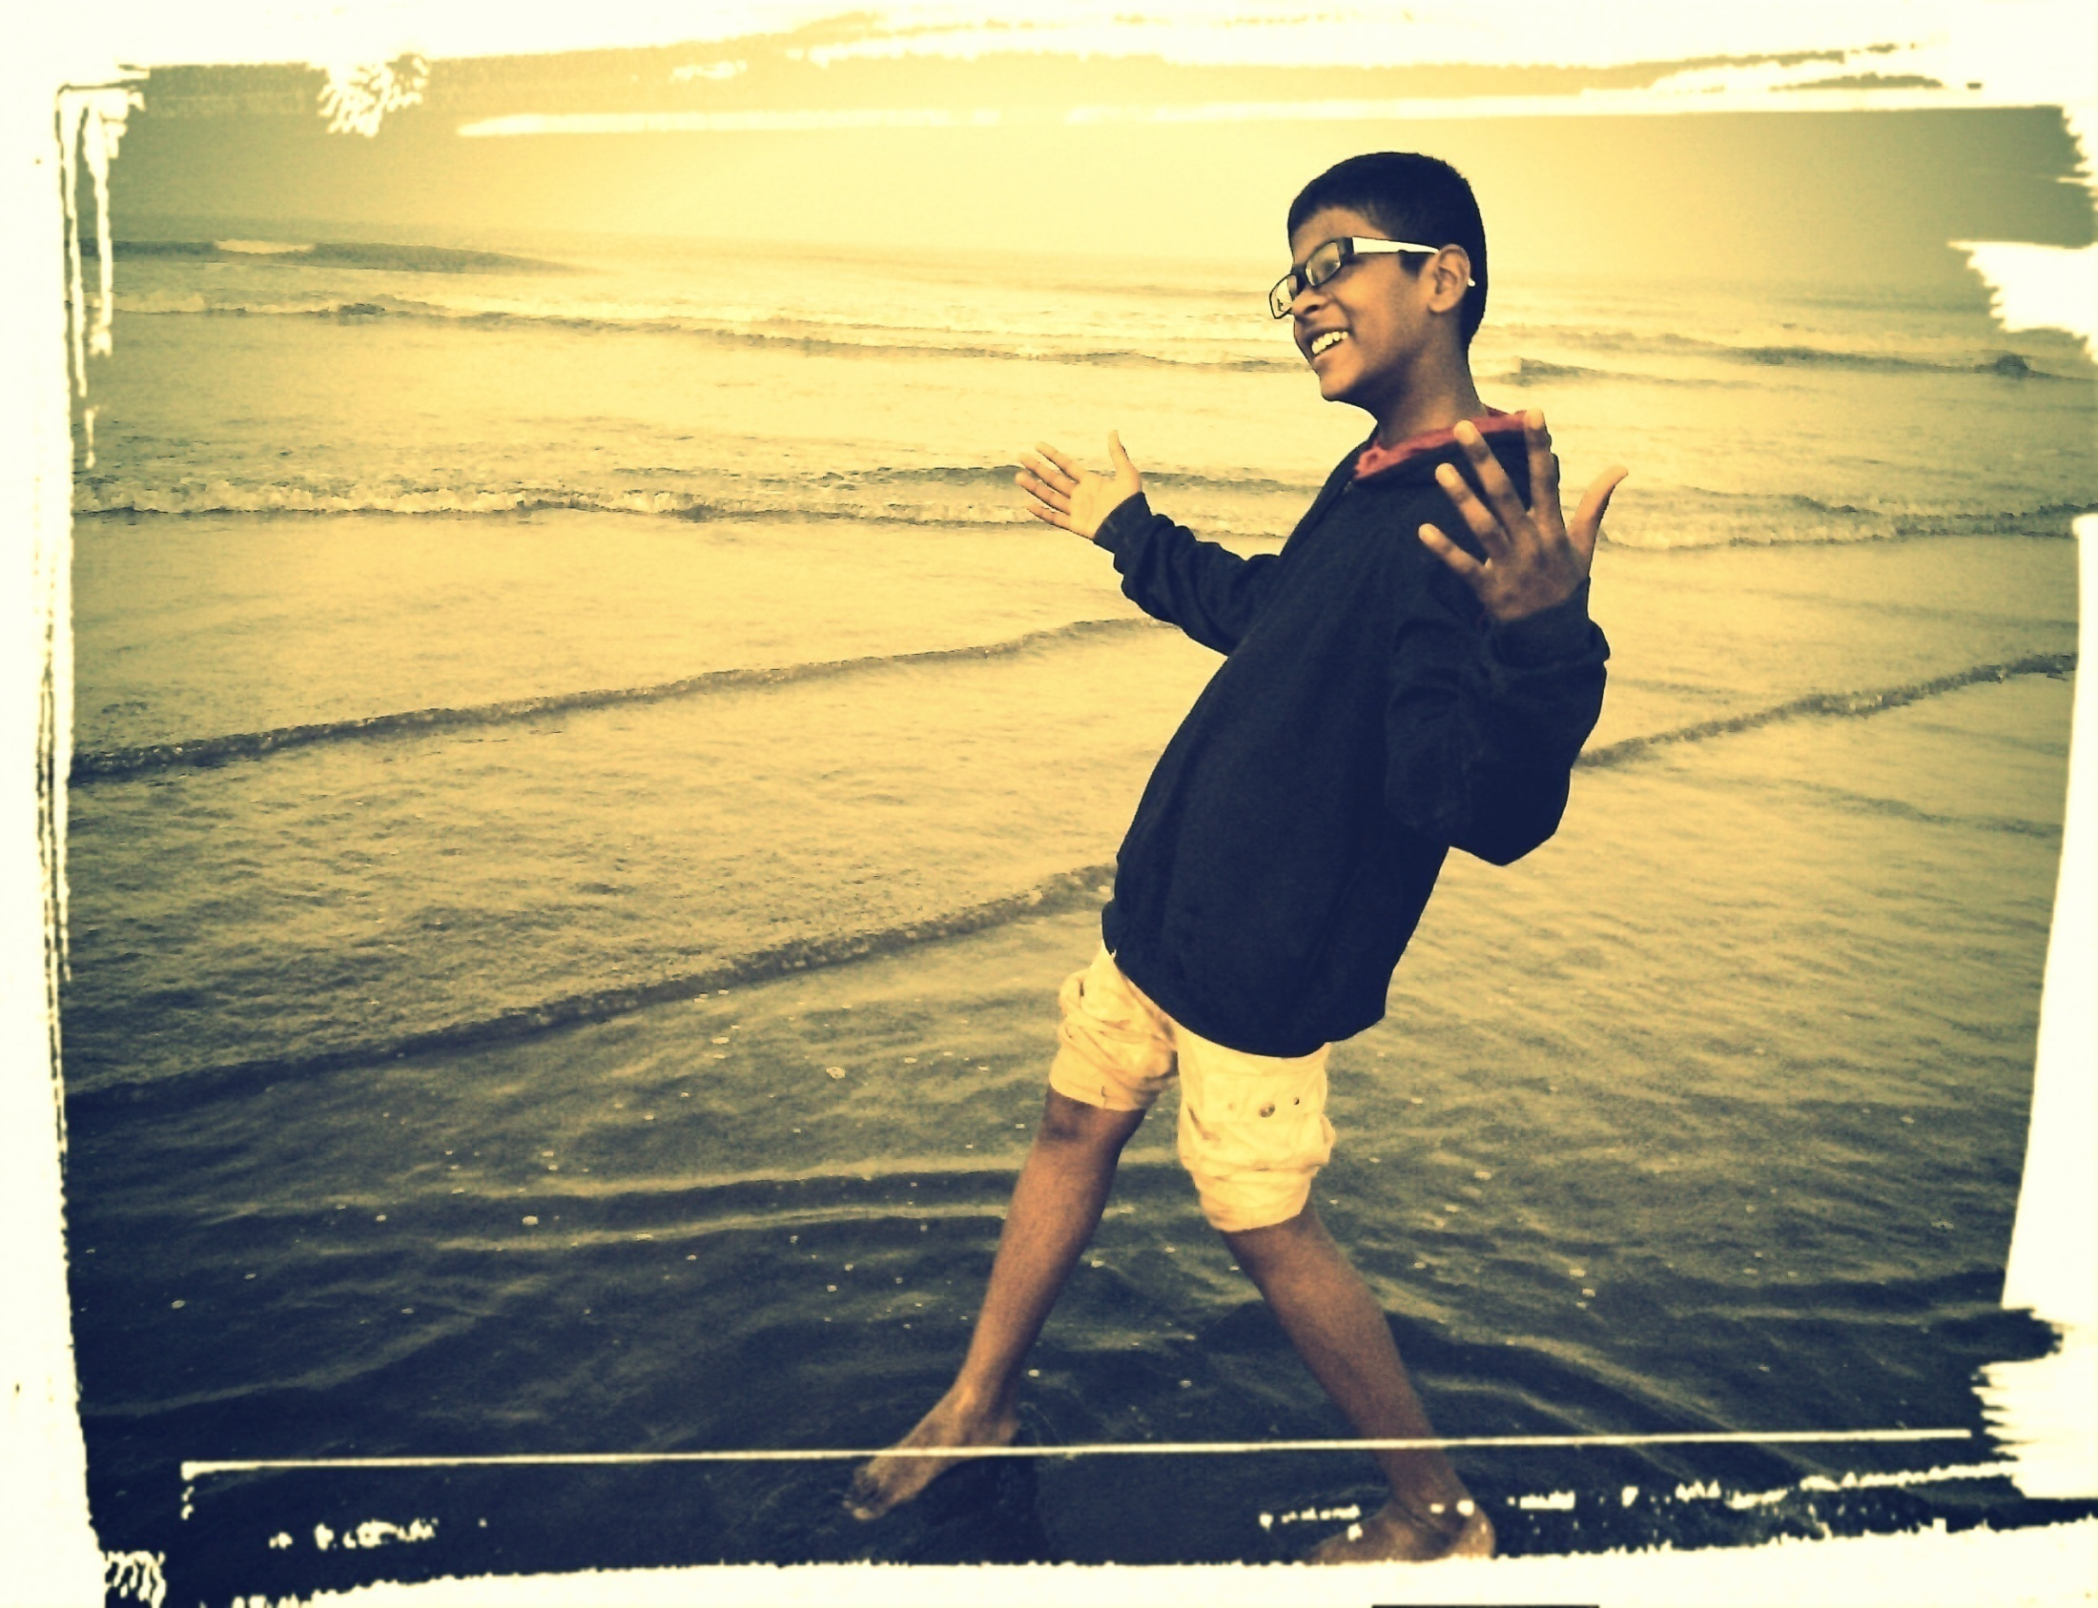
HI! My name is Yash. I am from Pawar Public School. I am fourteen years old.
My hobbies are dancing, singing, reading books especially the Shakespeare series. I also love to play volleyball.
My ambition is to become the part of the defense forces and serve the nation to my fullest.

Slide 5
HI!
MY NAME IS SHRAWANI SAWANT AND I`M FROM PAWAR PUBLIC SCHOOL.
I`M 13YEARS OLD.MY HOBBIES ARE DANCING AND SOLVING MATH SUMS.
MY AMBITION IS TO BECOME AN IPS OFFICER AND SERVE MY NATION.

Slide 6
HI! I AM DARSH JHALA .I AM FROM PAWAR PUBLIC SCHOOL & I AM 14 YEARS OLD.
I LOVE TO PLAY BASKETBALL AND TRAVEL.
I WANT TO BECOME A DOCTOR.

Slide 7
Hi! My name is Amrutavalli Chivukula but I like being called Amruta since its too long
I like reading books and listening to different songs.
I am from Pawar Public School and I am thirteen years old.
I always wanted to participate in EUMIND project. When I grow up, I want to become a singer

Slide 8
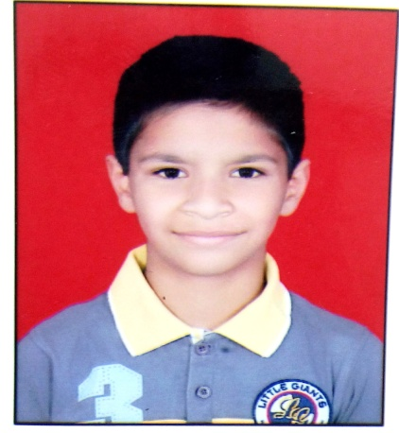
MY NAME IS ADVAIT KELAPURE. I AM FROM CLASS VIII B. I HAVE A GREAT INTEREST IN SPORTS. I LIKE PLAYING FOOTBALL ,CRICKET, KABADDI, BADMINTON AND OPERATING ELECTRONIC GADGETS. MY HOBBIES ARE READING BOOKS AND CYCLING. MY AMBITION IS TO BE A SUCCESSFUL SOFTWARE ENGINEER.

Slide 9
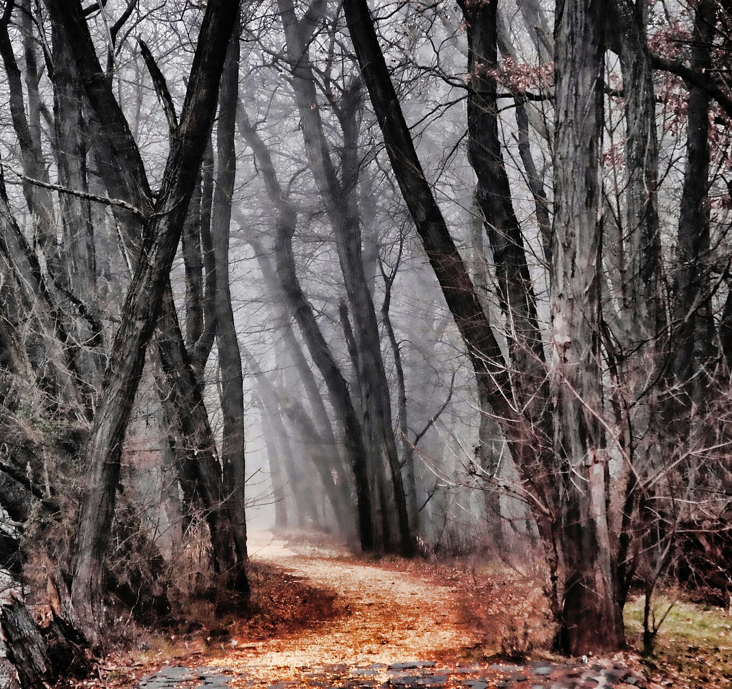
ACTION
PLAN

Slide 10
STUDENT EDITOR- Prathemesh Satpute
RESEARCHER- Yash Shinde
QUESTIONAIRE CREATOR- Shravani Sawant
PHOTOGRAPHER 1- Darsh Jhala
PHOTOGRAPHER 2- Advait Kelapure
INTERVIEWER- Amruta Chivukula
We have researched many math contributors from India as well as internationally and we have assigned two math contributors to each of the group members for research.

